Slide 1
Checking and securing finding a fraction of a given amount
Understanding multiplicative relationships: fractions and ratio

Slide 2
how to use Oak lessons

Slide 3
I can find a fraction of a given amount.

Slide 4
The reciprocal is the multiplicative inverse of any non-zero number. Any non-zero number multiplied by its reciprocal is equal to 1.

Slide 5

Checking and securing finding a fraction of a given amount
Using a bar model to find fractions of amounts
Fractions of amounts as multiplication
Fractions greater than 1

Slide 6






Using a bar model to find fractions of amounts
What fraction of each bar is shaded in each of the following?

Slide 7

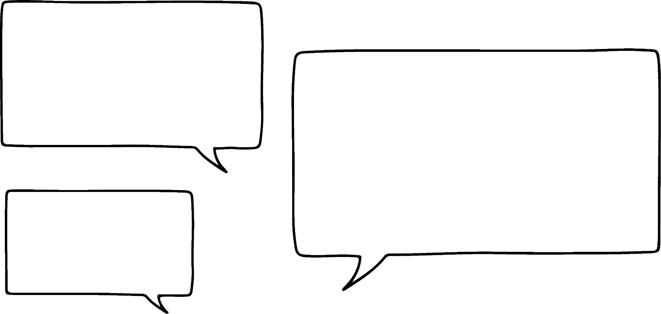


Using a bar model to find fractions of amounts
What value does the whole bar represent?
20
1
Could we use this bar model to help us find of an amount?
Yes, we can change the value the whole bar represents.
Aisha
Lucas

Slide 8
Using a bar model to find fractions of amounts
What is of 20?
20 ÷ 5 = 4
4 | 4 | 4 | 4 | 4
2 × 4 = 8
That means that of 20 is 8.
Yes, and as we want to find we need to multiply 4 by 2 to give us 2 parts.
Share the 20 into the 5 equal parts.
So, each part is worth 4
Aisha
Lucas

Slide 9

Using a bar model to find fractions of amounts
Calculate of £26.40 = £16.50
£26.40 ÷ 8 = £3.30
£3.30 | £3.30 | £3.30 | £3.30 | £3.30 | £3.30 | £3.30 | £3.30
£3.30 × 5 = £16.50
Could we use it to answer this question?
Yes, the whole bar represents £26.40.
Aisha
Lucas

Slide 10


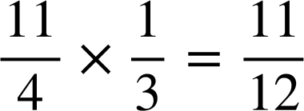
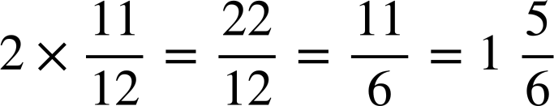
Using a bar model to find fractions of amounts
What is of ?
÷ 3
Oh yes, and multiply by the reciprocal of the divisor.
Lucas, you remember. Convert the mixed number into an improper fraction.
How do we do this?
And this type of question?
I don’t see why not.
Aisha
Lucas

Slide 11

Using a bar model to find fractions of amounts
6300 grams
?
It is split into 9 equal parts and 2 are shaded so it could be
what is of 6300 grams?
What question does this bar model represent?
Aisha
Lucas

Slide 12




Using a bar model to find fractions of amounts
Which of the following bar models is not set up correctly?
Justify your answer.
c − the bar shows not
What is of £8.65?
What is of 4500 m?
What is of ?
£8.65
4500 m
?
?
?

Slide 13

Using a bar model to find fractions of amounts
What is of £350?
What is of £400?
£350 ÷ 5 = £70
£400 ÷ 5 = £80
?
?
£70 × 3 = £210
£80 × 4 = £320

Slide 14
Using a bar model to find fractions of amounts
Use the bar models to answer the following:
of 40
of 40
of 40

Slide 15



Using a bar model to find fractions of amounts
Use the bar models to answer the following:
of 40
of 40
of 40

Slide 16
Using a bar model to find fractions of amounts
Use the bar models to answer the following:
of 40 = 8
of 40 = 24
of 40 = 15
of 40 = 35
of 40 = 12
of 40 = 28

Slide 17
Checking and securing finding a fraction of a given amount
Using a bar model to find fractions of amounts
Fractions of amounts as multiplication
Fractions greater than 1

Slide 18
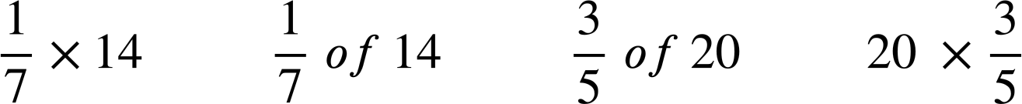
Fractions of amounts as multiplication
Aisha and Lucas are answering the following questions:
of 14
What is the same and what is different about the calculations?
E.g. The both have a 1 as the numerator.
They both have a 7 as the denominator.
They both use the integer 14.
One has a multiplication symbol and the other says ‘of’.

Slide 19
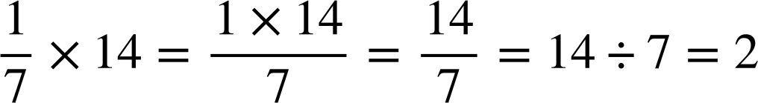
Fractions of amounts as multiplication
Here are their strategies for answering each question:
What is the same and what is different about the strategies?
14
E.g. Both divide 14 by 7
Both have the same answer of 2
Only the second one used a bar model.
of 14
2 | 2 | 2 | 2 | 2 | 2 | 2
of 14 = 2

Slide 20
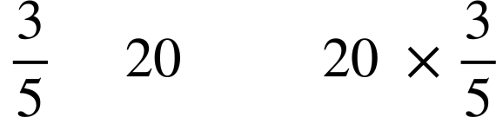
Fractions of amounts as multiplication
Aisha and Lucas are answering the following questions:
of
What is the same and what is different about the calculations?
E.g. They both have a 3 as the numerator.
They both have a 5 as the denominator.
They both use the integer 20.
One has a multiplication symbol and the other says ‘of’.
In the second one, the fraction is second in the calculation.

Slide 21
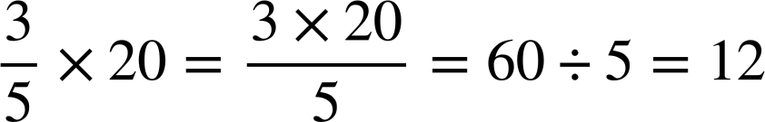
Fractions of amounts as multiplication
Here are their strategies for answering each question:
20
What is the same and what is different about the strategies?
of 20
4 | 4 | 4 | 4 | 4
E.g. Both divide by 5
Both multiply by 3
Both get the same answer of 12
The second one has fewer steps.
of 20
= 3 × 4
= 12

Slide 22
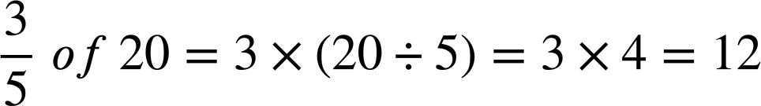
Fractions of amounts as multiplication
Does this mean that multiply and ‘of’ are the same thing?
Yes, and multiplication and division have equal priority.
Because we are using the same numerators, the same denominators, the same amount and only multiplication and division they are the equivalent.
Aisha
of
Lucas
REMEMBER: a fraction is an alternative way of showing division.

Slide 23
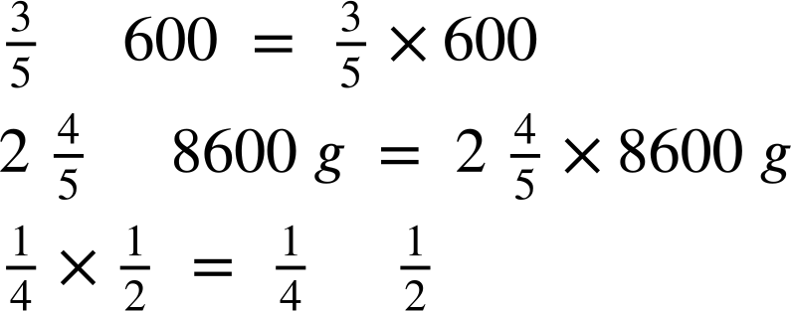
Fractions of amounts as multiplication
The word ‘of’ and the process of multiplying in maths are the same thing.
E.g.
of
of
of

Slide 24
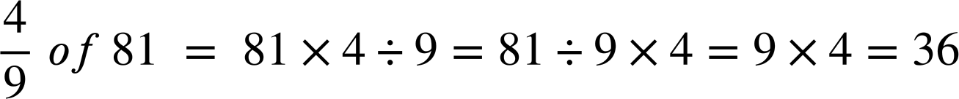
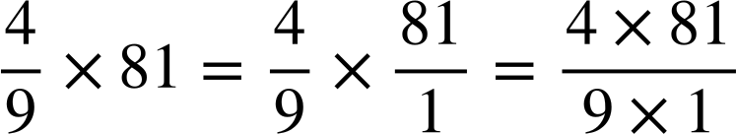
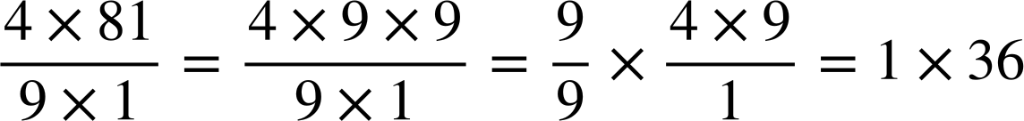
Fractions of amounts as multiplication
Knowing that fractions of amounts can be written as multiplications, we can multiply fractions efficiently.
You don’t need to write out all of these steps, this is just to show you.
of
Now we can look for common factors between the numerator and denominator to calculate efficiently.
Again, you will not need to write out all of these steps every time.

Slide 25
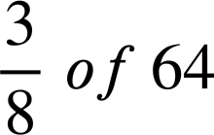
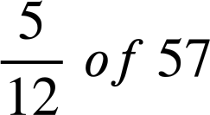
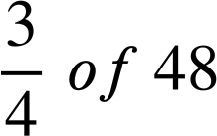
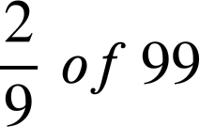
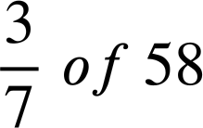
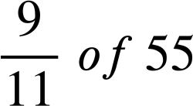
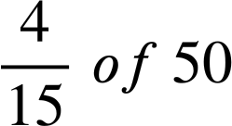
Fractions of amounts as multiplication
Sort the following into the most efficient method:
Multiply 1st
Divide 1st

Slide 26
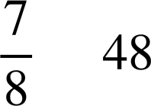
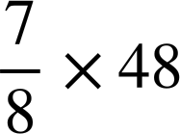

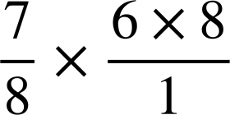

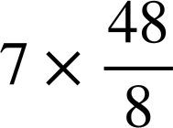
Fractions of amounts as multiplication
Which of the following are equivalent calculations for ?
of
They are all equivalent!
Are some ways easier to calculate mentally than others?

Slide 27
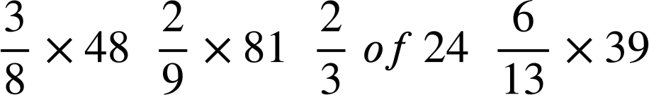

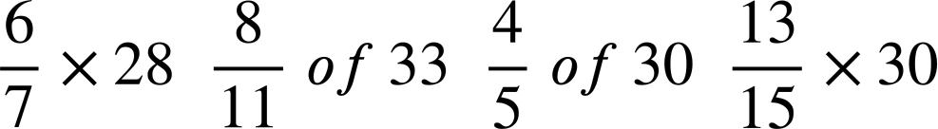

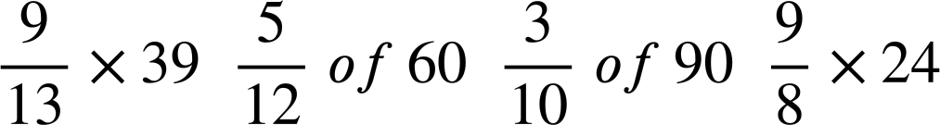

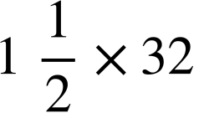

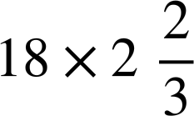


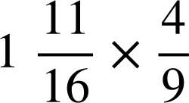
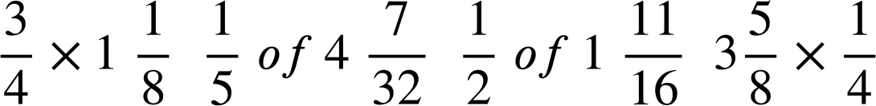

Fractions of amounts as multiplication
Find the odd one out in each row. It has a different answer to the others.
Arrange the letters of these into a word.
A
I
E
U
S
N
Y
R
M
P
W
C
D
E
O
G
T
R
F
H
P
T
L
K

Slide 28



Fractions of amounts as multiplication
Find the odd one out in each row. It has a different answer to the others.
Arrange the letters of these into a word.
18
A
18
I
16
E
18
U
24
S
24
N
24
Y
26
R
27
M
25
P
27
W
27
C
48
D
48
E
49
O
48
G
T
R
F
H
P
T
L
K
The word is PROPER

Slide 29
Checking and securing finding a fraction of a given amount
Using a bar model to find fractions of amounts
Fractions of amounts as multiplication
Fractions greater than 1

Slide 30
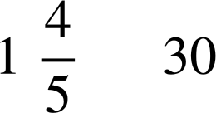
Fractions greater than 1
What would a bar model look like for calculating:
of
30
30
1
30 ÷ 5 × 4 = 6 × 4 = 24
30 + 24 = 54
How can a fraction of an amount be greater?
We are finding more than one whole. Multiplying anything by a number greater than 1 will give a greater product.
Aisha
Lucas

Slide 31
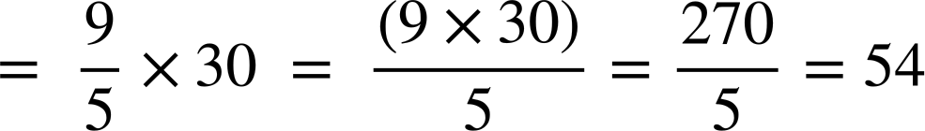
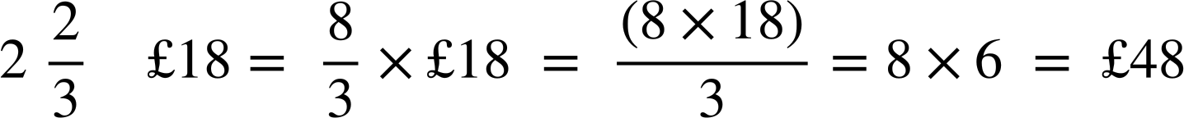
Fractions greater than 1
But we now know that ‘of’ means the same as multiply.
of
of

Slide 32
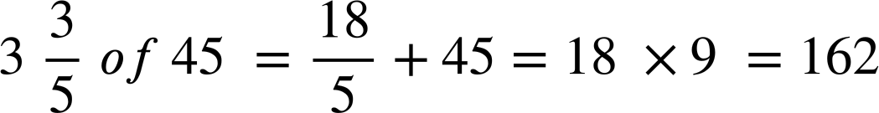
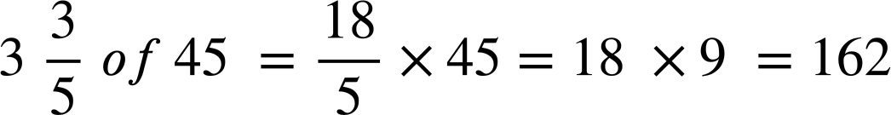
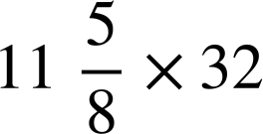
Fractions greater than 1
Aisha and Lucas are calculating
of
Aisha’s method:
of
Lucas’ method:
of
When might Aisha’s method be more useful?
What is the same and what is different about the 2 methods?
When dealing with large mixed numbers.
E.g.
E.g They both get the same answer.
Aisha has partitioned the 3 and
Which method do you prefer?

Slide 33
Fractions greater than 1
What is ?
What is ?
of

Slide 34



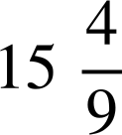
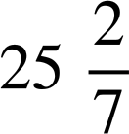
Fractions greater than 1
Calculate the following:
of 180
of 48
of 136
of 30
of 21

Slide 35
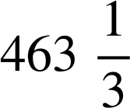
Fractions greater than 1
Calculate the following:
of 180 = 324
of 48 = 84
of 136 = 799
of 30 =
of 21 = 531

Slide 36
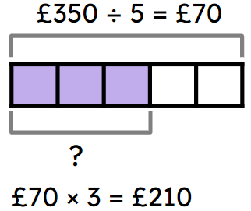
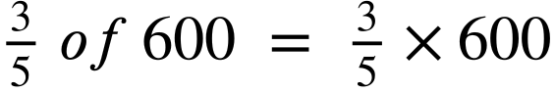
Checking and securing finding a fraction of a given amount
A bar model is useful for finding a fraction of an amount.
E.g.
Multiplication and ‘of’ are equivalent in maths.
E.g.
When finding a fraction of an amount, the order in which you multiply and divide does not matter as they have equal priority.

Slide 37

© Oak National Academy 2023.
Produced in partnership with Mathematics in Education and Industry.
Licensed on the Open Government Licence v3.0, except where otherwise stated. See Oak terms and conditions.

